Slide 1
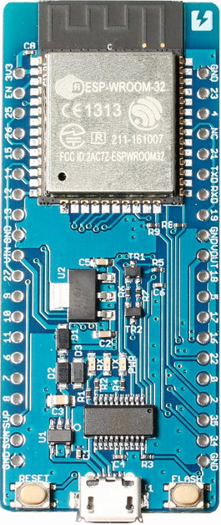

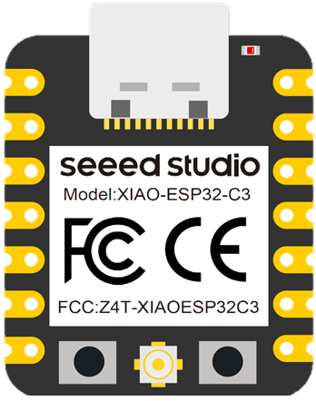
Sender
Receiver
ESP-NOW
PC
Parent
Children
Main MCU
Xiao ESP32 C3
Xiao ESP32 C3
ESPr Developer 32
（ESP-WROOM-32）

